Slide 1
Stop logging into your servers!
The pros and cons of Windows Admin Center

Slide 2
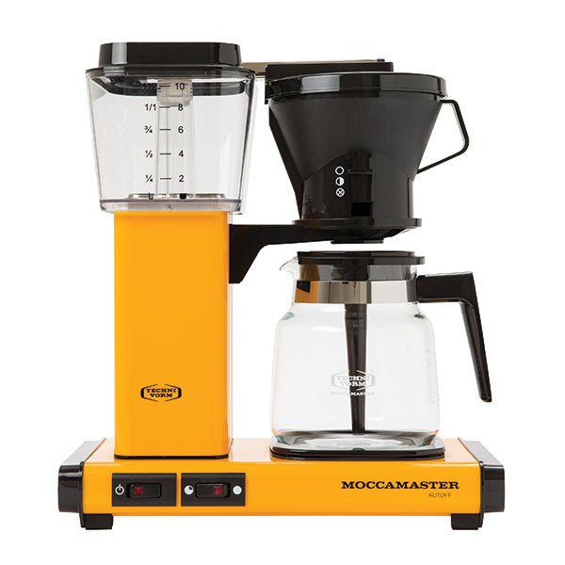
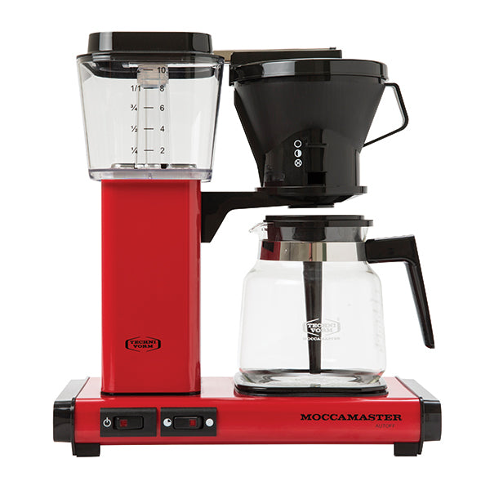

Ben Reader
Jordan Benzing
Code Monkey, Patch My PC
Lord of security, Patch My PC
@powers_hell
💻 powers-hell.com
@JordanTheITguy
💻 jordantheitguy.com
Notes:
Who are we?

Slide 3
Come join the WAC PAC
PowerShell over the internet, what could possibly go wrong

Slide 4
Summary
Why are we here? What is the meaning of life?
What’s the issue with logging onto my critical infrastructure?
What is “Server core” and why should I care?
All of my servers look like ~Linux~ now… How do I… do things?
Configuring Windows Admin Center on a jumpbox.
Certificates (because they will never go away).
Jordan does a dance, or pours ben a coffee… maybe both?
Notes:
We are going to go over the process of installing WAC.
We will cover each of these points. Through this session.

Slide 5
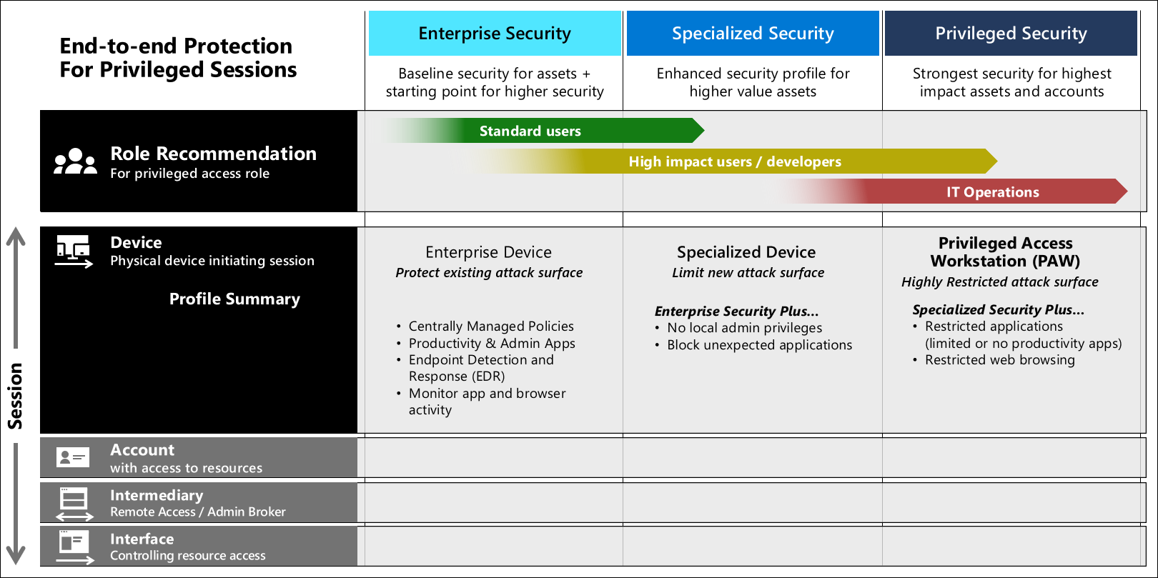
PAWS – No not dog paws.
You probably aren’t using them. So use the next best thing.
Notes:
PAWS are complicated, and if you do them wrong provide next to minimal value on the level of investment required to make them work. PAWS have a few different deployment models, but at the end of the day they are simply designed to create a machine, where you don’t leave your credentials lay

Slide 6
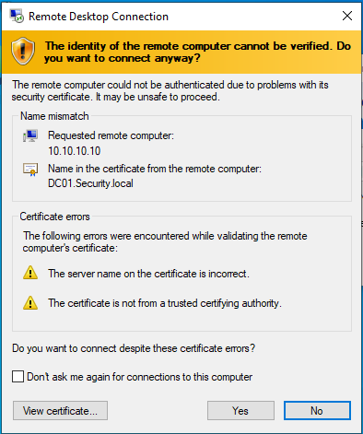
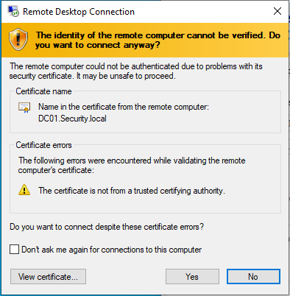
Some bed time reading on why RDP bad
Dumping RDP Credentials – Penetration Testing Lab (pentestlab.blog)
RDP MiTM - Pentest Everything (gitbook.io)

Slide 7
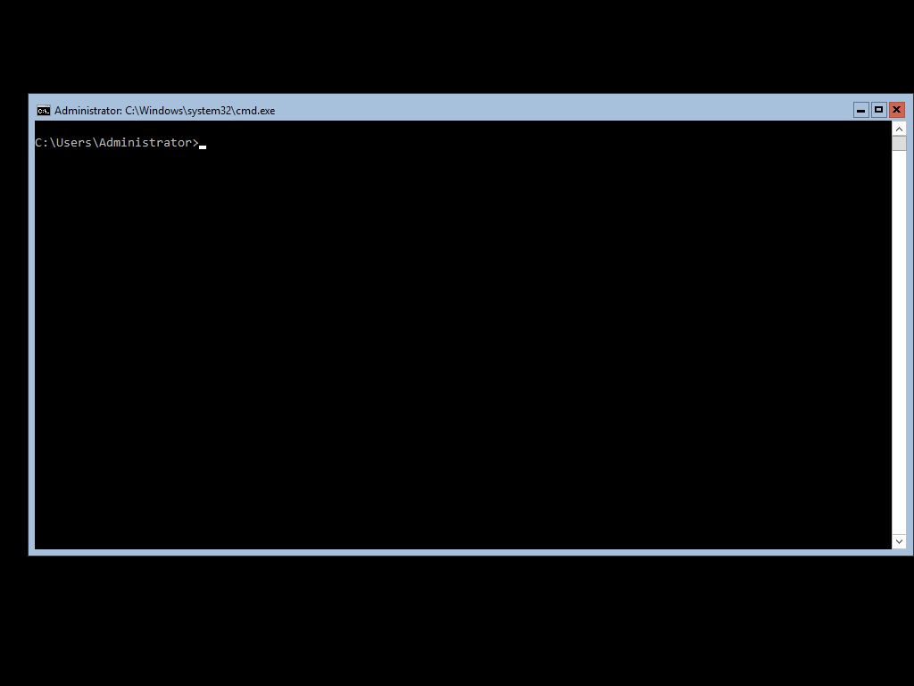
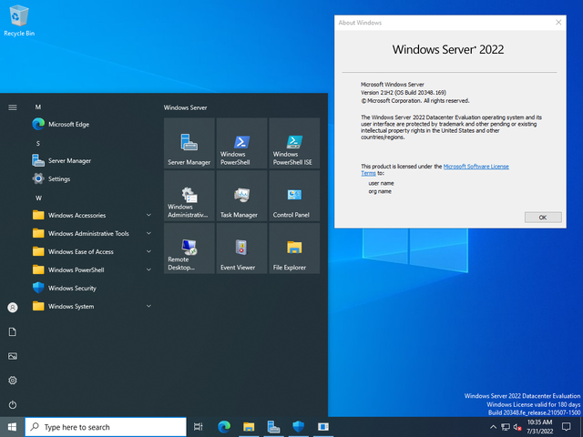
Server Core – AKA - first we kill all the GUI

Slide 8
No seriously, what?
A quick showcase of what CORE looks like for those who haven’t’ seen it.

Slide 9
What dark rock did this come from
Project Honolulu
At Ignite 2017, we unveiled the technical preview of Project “Honolulu” to the world for the first time. It sparked a flame of excitement in IT admins’ hearts.
One. Little. Tiny Booth. – Ignite 2017
As of now it’s somehow only on a quarter of a million servers.
Notes:
Talk about how the project never got it’s big massive Debut like the other major products = See Arc
Why? – Because it’s not a revenue generating product.

Slide 10
Why do I care?
Stop. Logging. Into. Your. Servers
Everyone wants a single pane of glass
If you have experience with Azure this is kinda “Azure on Prem”
Steal all of the PowerShell, add some logs..?? Profit?
Manage… from A Boat?
There are certain MMC’s that just … don’t work.

Slide 11
How to stop logging into your servers… mostly
According to a pair of coffee makers

Slide 12

You covered a lot of things…
Download Windows Admin Center
Install Windows Admin Center | Microsoft Learn
The REALLY IMPORTANT BIT
- Updating Certificates (Ben put link here)
High Availability WAC

Slide 13
Go forth to honolu.. I mean WAC
If your tired of old crappy MMC consoles, use WAC.
Ask yourself if you really need to RDP into a server.
Manage your servers from a boat, because you can.

Slide 15


